Slide 1
EMPLOYEES BURNOUT ANALYSIS AND PREDICTION

Slide 2

Student Details
Name : AKULA PRANATHI
Skillsbuild Email ID : pranathiakula35@gmail.com
College Name : GIET Engineering College
College State : Andhra Pradesh
Internship DOMAIN : ARTIFICIAL INTELLIGENCE
Internship START DATE : 03/06/2024
Internship END DATE : 15/07/2024

Slide 3
Project topic
The project analyzes employee burnout using data-driven insights and predictive modeling to identify its causes, indicators, and risk factors within the organization.
Based on the analysis, the project implements targeted interventions to create a healthier work environment, enhance employee engagement, and mitigate burnout, fostering organizational success and growth..
The results showed that previous absenteeism, job evaluation scores, and feeling supported by colleagues were good predictors of future absenteeism.

Slide 4
AGENDA
Project Overview
End Users
Solution and Value Proposition
Customization for an Organization
Modelling
Results
Links

Slide 5
PROJECT OVERVIEW
The Employees Burnout Analysis and Prediction project addresses employee burnout within the organization. By leveraging data-driven insights and predictive modeling, I analyze and predict burnout risks.
The project focuses on identifying causes, developing targeted interventions, and fostering a culture of well-being. My goal is to create a healthier work environment, enhance employee engagement, and drive organizational success.
The document discusses a project that aimed to predict employee absenteeism using predictive analytics. It describes some of the key factors for the project's success, including having an interdisciplinary team and creating a large number of potential predictor variables from available data.

Slide 6
END USERS
Organization Leadership
Human Resources (HR) Department
Managers and Supervisors
Employees

Slide 7
SOLUTION AND ITS VALUE PROPOSITION
Our solution combines data analysis, predictive modeling, and targeted interventions to address employee burnout and promote a healthier work environment.
By identifying burnout causes and risk factors, we can implement proactive strategies that enhance employee well-being and engagement.
The value proposition of our solution lies in reducing burnout-related costs, improving employee satisfaction and retention, and driving overall organizational success.

Slide 8
Customization for an Organization
The project was tailored to align with the unique needs and context of the organization. The data collection methods and analysis were customized to suit the specific employee population, ensuring the relevance and impact of the insights and interventions.
The organization's values, culture, and goals were incorporated into the project, making it a bespoke solution that addresses the organization's specific challenges and promotes desired outcomes. Through this customization, a project was created that is uniquely designed for the organization's success in addressing employee burnout and fostering a positive work environment.

Slide 9
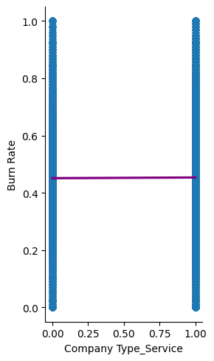
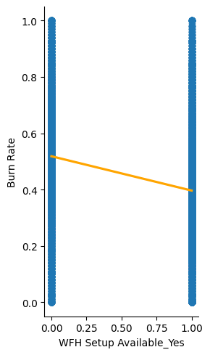
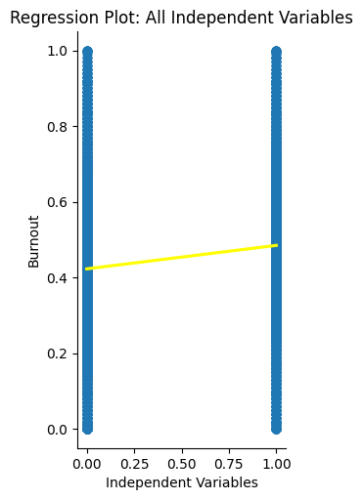
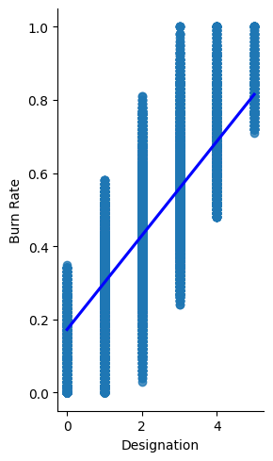
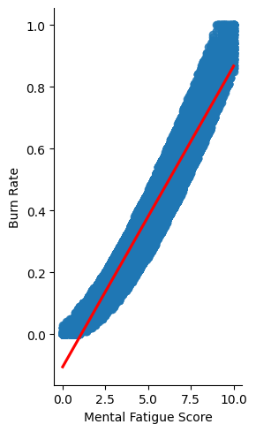
MODELLING : Linear regression

Slide 10
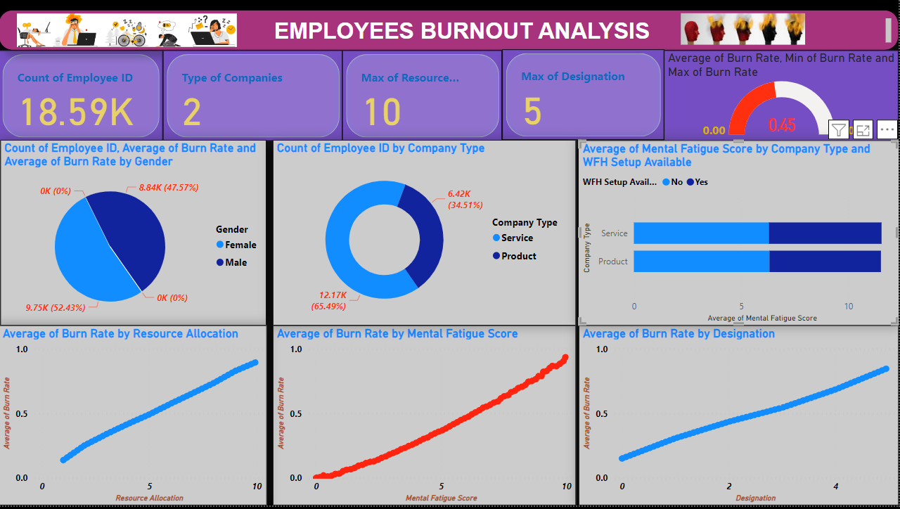
Exploratory Data Analysis (EDA)

Slide 11
Results
Prevalence of burnout
Contributing factors
Intervention strategies
To get more about the project visit this GitHub repository:
https://github.com/pranathi1703/employees-burnout-prediction-and-analysis.git

Slide 12
links
This is my GitHub project link:
https://github.com/pranathi1703/employees-burnout-prediction-and-analysis.git

Slide 13
Thank you..

